Slide 1
Data visualization and analysis
Task : 1) Collecting the three different dataset
2) making analysis and report of it

Slide 2
Data set 1: Automobile Data set
1) The data set of data from 1985 Ward's Automotive year book.
2)This data set consists of three types of entities:
(a) the specification of an auto in terms of various characteristics
(b) its assigned insurance risk rating
(c) its normalized losses in use as compared to other cars
3)Cars are initially assigned a risk factor symbol associated with its price.
4) The dataset consists of 26 column
Specification of the dataset
A) Strings - 16
B) Decimals - 05
C) Integers - 05

Slide 3
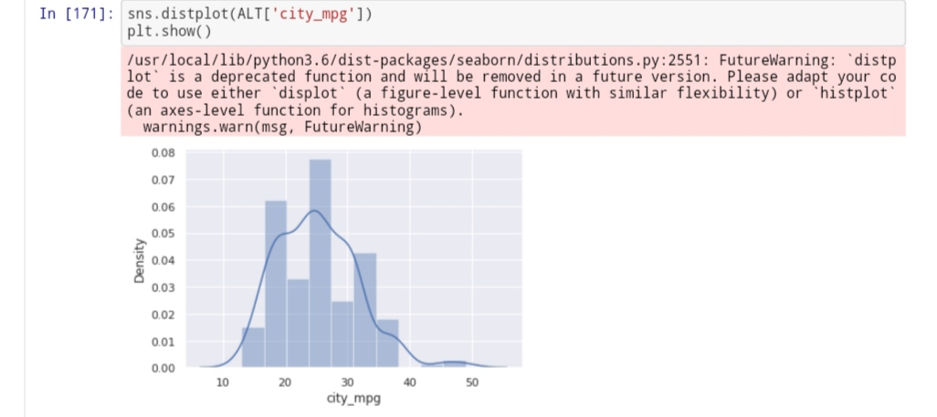
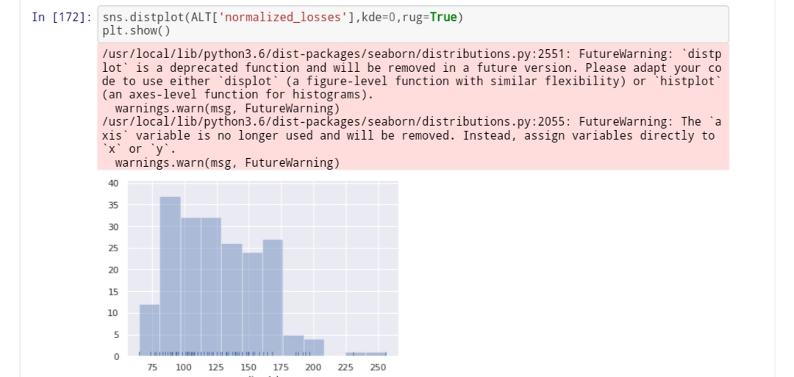
Visualization of Automobile Data set
Univariate Distribution
Univariate Distribution is used to analyze the distribution for single variable
In this above code snippet. We can see lines at the bottom of each bins which indicates the frequency of the variable , we can relate this as bin height increases the concentration of the lines in that bin also increases

Slide 4
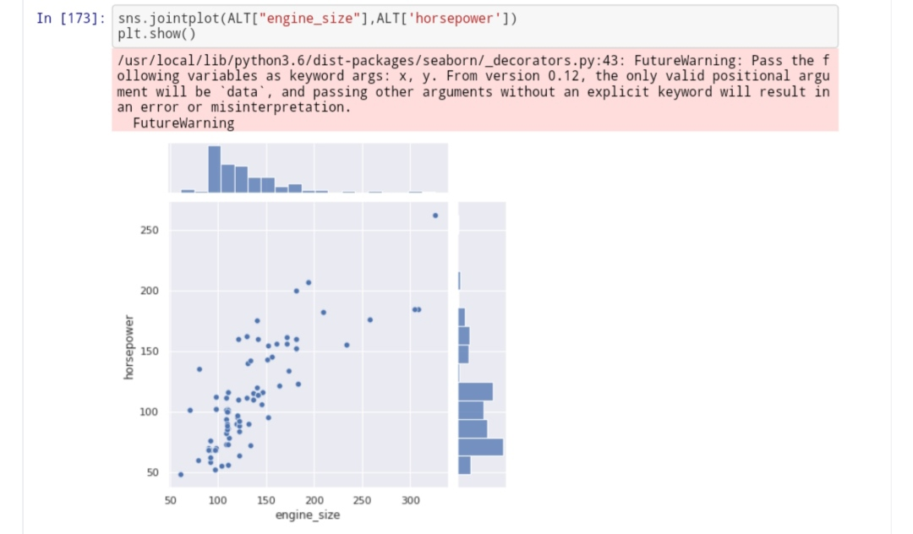
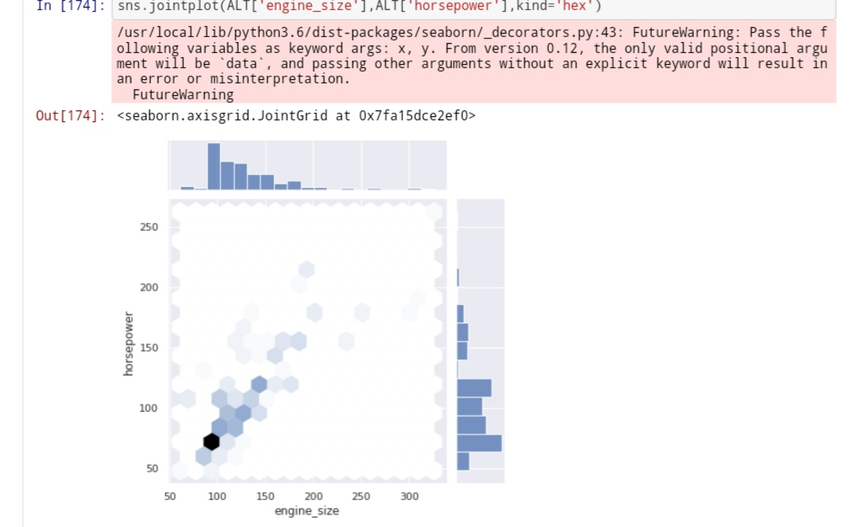
Bivariate Distribution:
It is used to analyze any Two continuous variables
We used Two kind of plots here ,Basically bivariate plots are used to see the correlation between Two variables ,By looking above plots we can conclude that both variables have a positive correlation. By above plots we can get insights for three things
1) Distribution of Engine size 2) Distribution of Horse power 3) Correlation between this two features
In second plot I used hexagon instead of the scatter as the concentration of hexagon is more we can conclude observation at such points are more

Slide 5
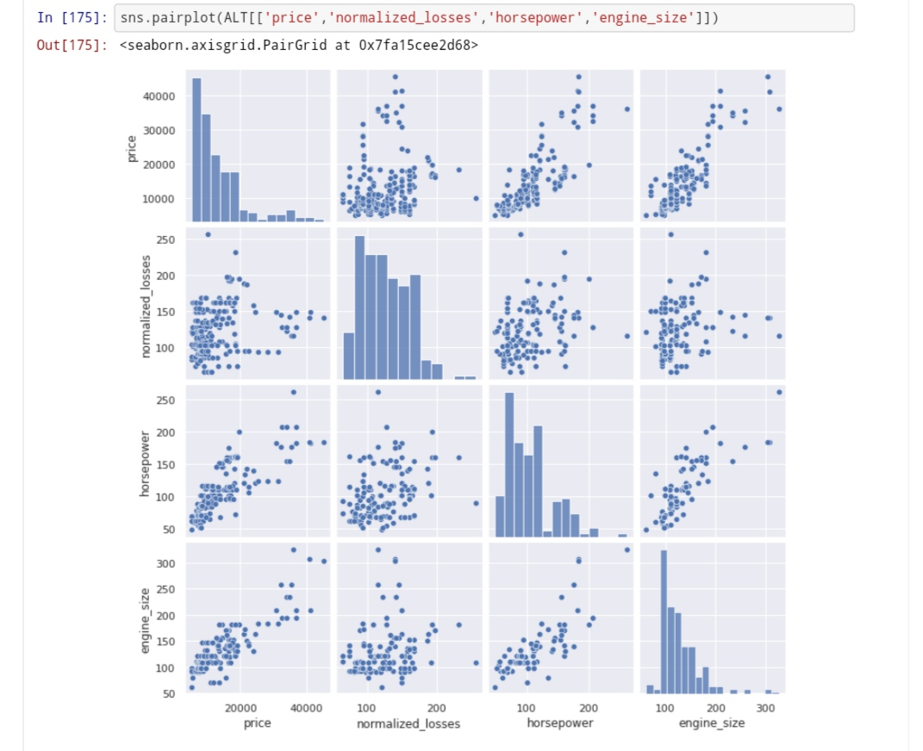
Multivariate distribution:
This kind of plots are used to analyze more than 2 features at a time in single plot.
In this plot, we clearly see that the diagonal plots are histograms which means we can analyze all the features distribution in only one plots and also we can get the correlation of features in single plot itself. If we observe carefully the Upper and Lower triangles are nothing but mirror image of each other's

Slide 6
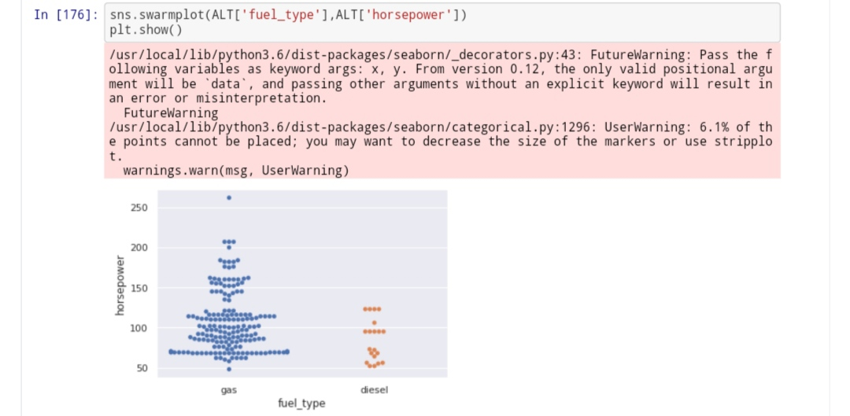
By this plot we can see layer wise distribution of data the insights that can be drawn from the plots are
1) We have an imbalance dataset
2) More vehicles have their horsepower range between ~ (75-125)

Slide 7
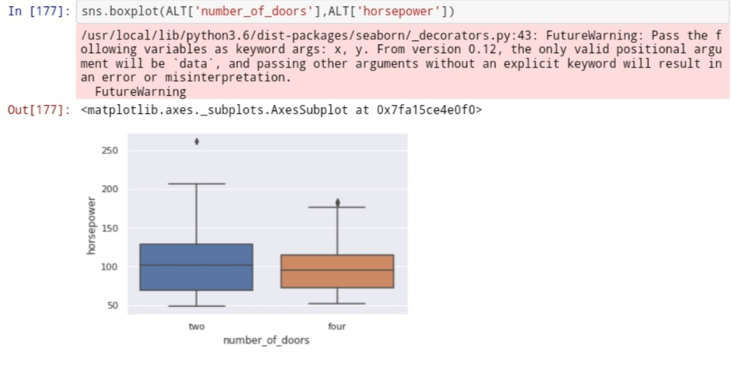
BOX PLOT
This plot is known as boxplots used for statistic purpose
1) The top and bottom line of the viscous tells us the maximum and minimum value from above plot we see for 2 door car the maximum value is around 220 and minimum value is exactly 50, and for 4 door car the maximum value is around 170 and minimum value is around 50
2) The 25th percentile,75th percentile and the median/50th percentile can be seen
3) The points outside the plots are the outliers.

Slide 8
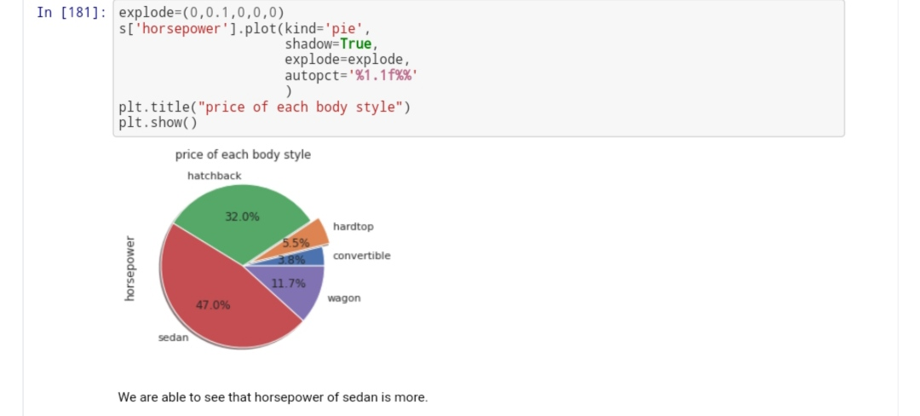
Pie Chart:
The main purpose for usage of this kind of plots is we can see the distributions of the data with both metrics and dimensions at a time.

Slide 9

Dataset 2: Environmental Sensor Telemetry Data
The data was generated from a series of three identical, custom-built, breadboard-based sensor arrays. Each array was connected to a Raspberry Pi devices. Each of the three IoT devices was placed in a physical location with varied environmental conditions.
It consists of 9 columns
| ts | timestamp of event | epoch | | device | unique device name | string | | co | carbon monoxide | ppm (%) | | humidity | humidity | percentage | | light | light detected? | Boolean | | lpg | liquid petroleum gas | ppm (%) | | motion | motion detected? | Boolean | | smoke | smoke | ppm (%) | | temp | temperature | Fahrenheit |
Detail Image of Sensor Image

Slide 10
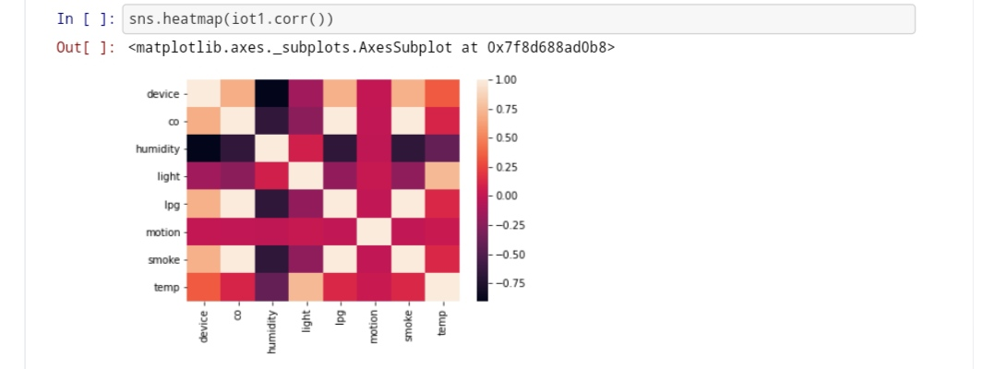
Heat Map:
This plot is used to know the correlation of one metric with another.
This plot is widely used during exploratory data analysis.

Slide 11
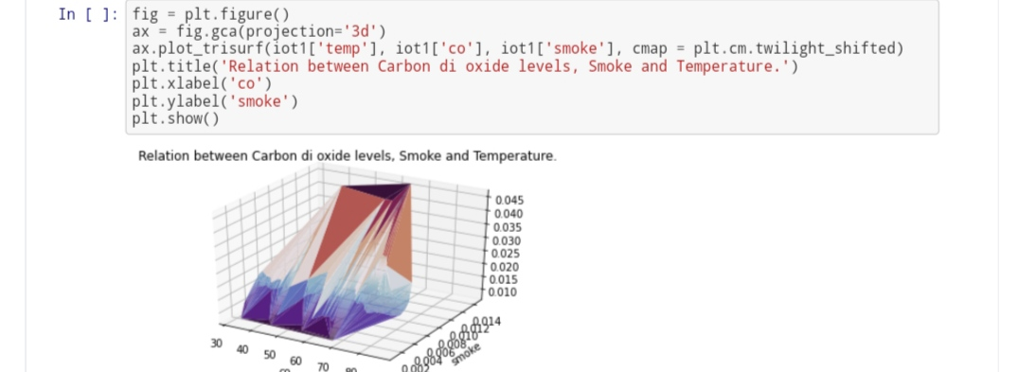
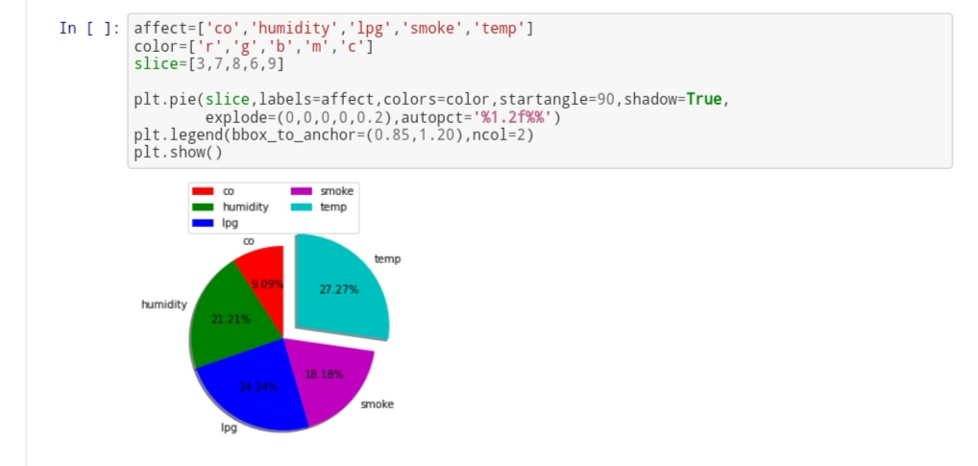

Slide 12
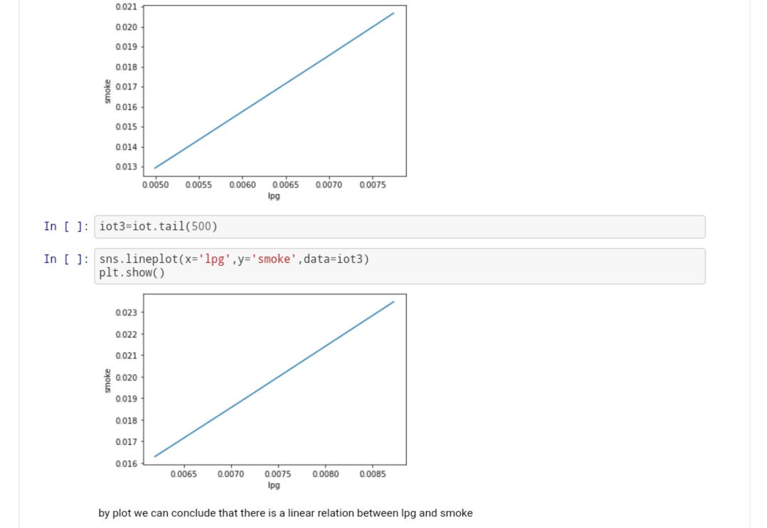
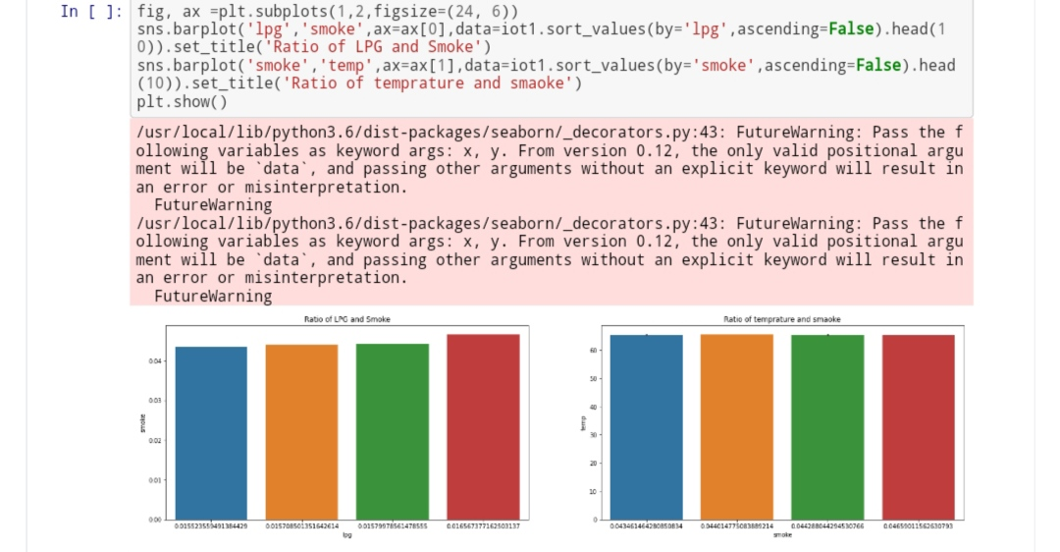
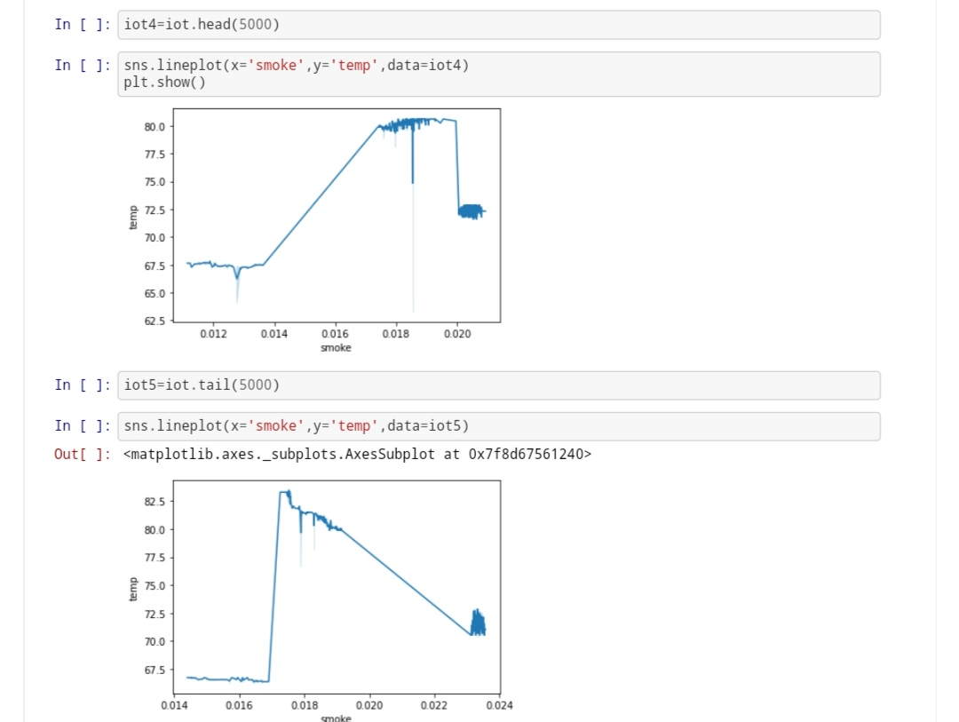

Slide 13
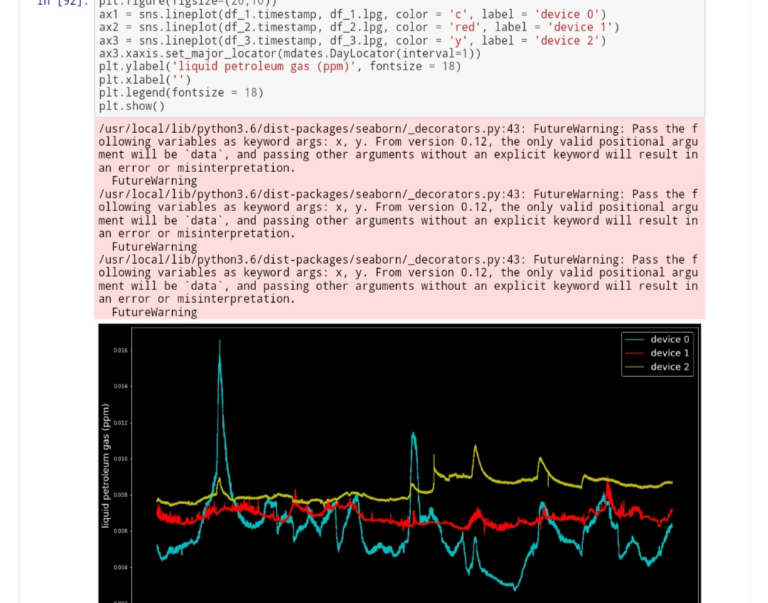
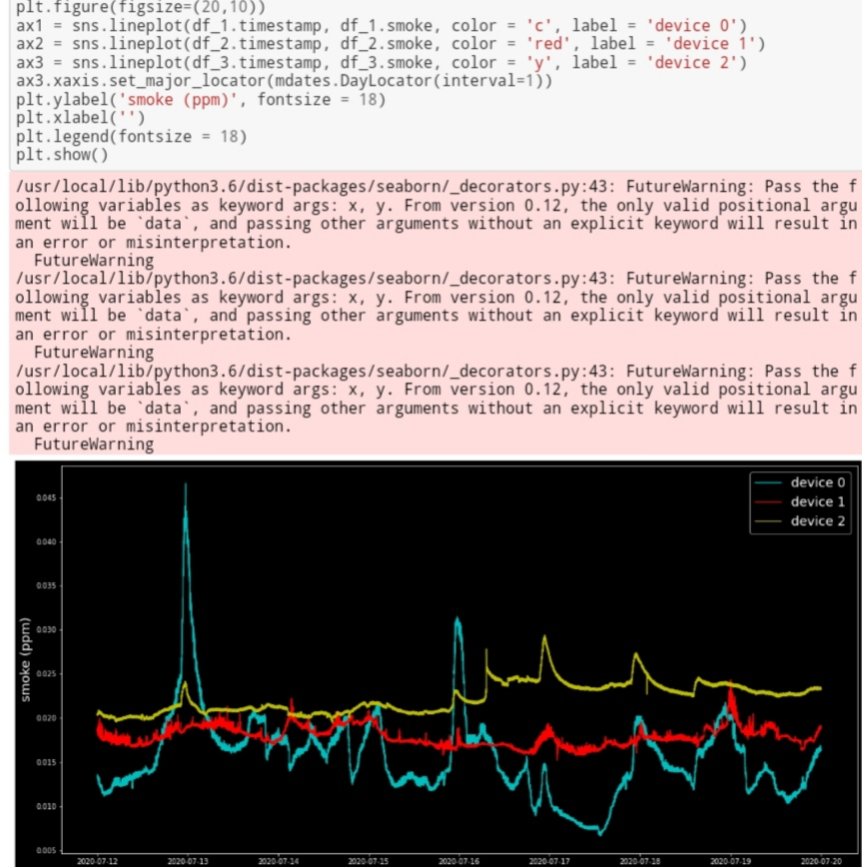

Slide 14
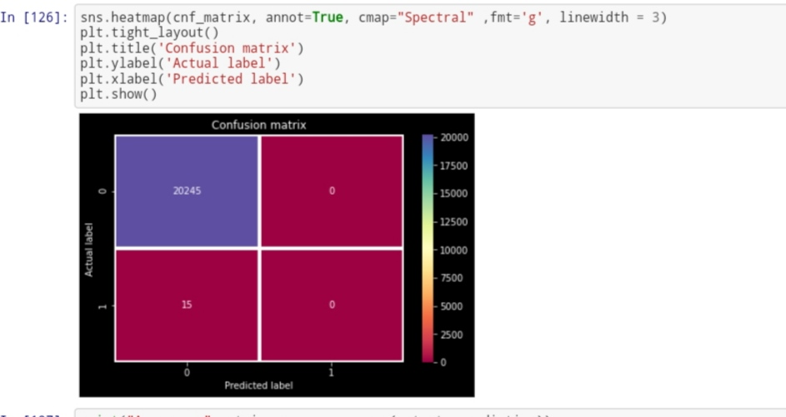
Confusion Matrics

Slide 15
Dataset 3: Smart Home Dataset with weather Information
This CSV file contains the readings with a time span of 1 minute of house appliances in kW from a smart meter and weather conditions of that particular region.
The dataset consists of 32 column
Specification of the dataset
A) Strings - 27
B) Decimals - 03
C) Integers - 02

Slide 16
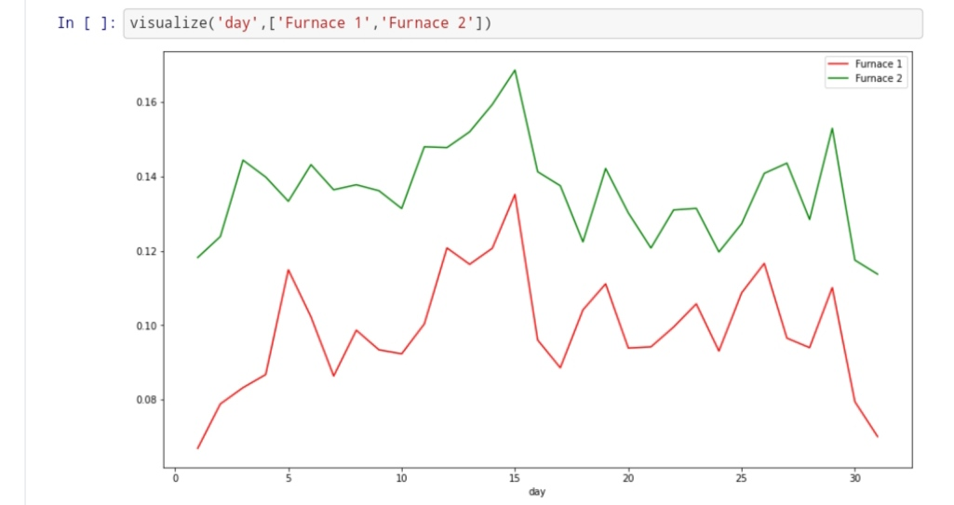
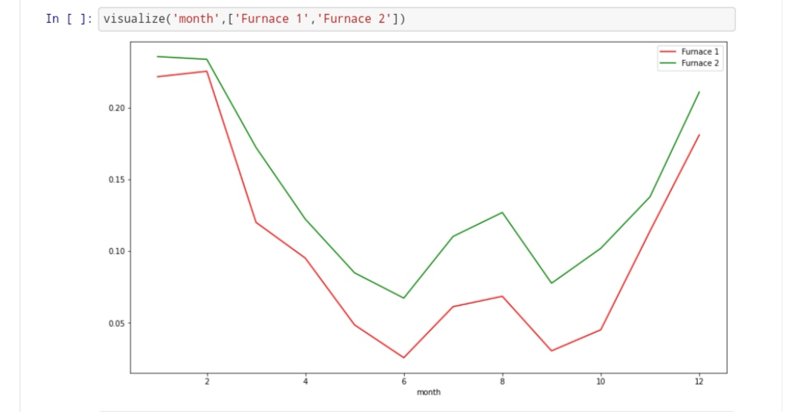
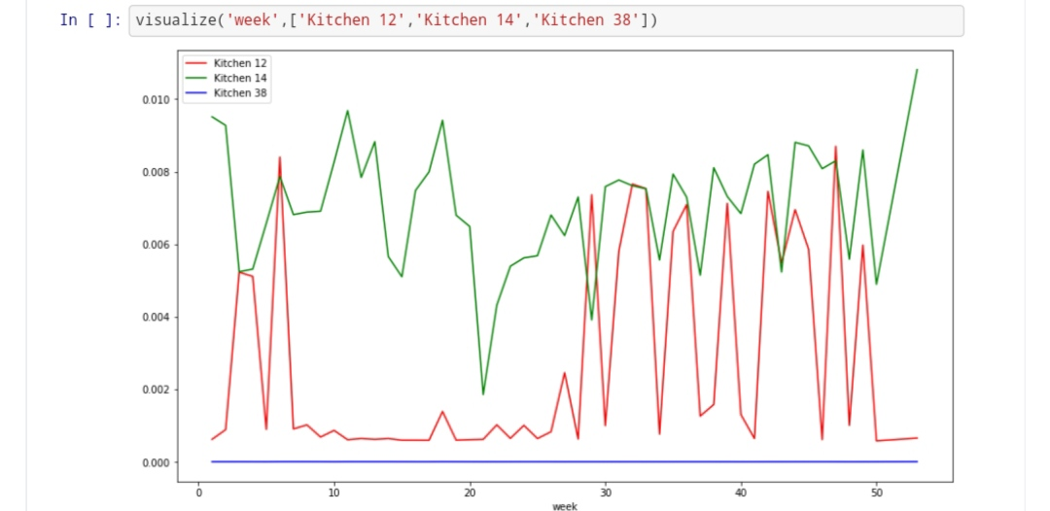
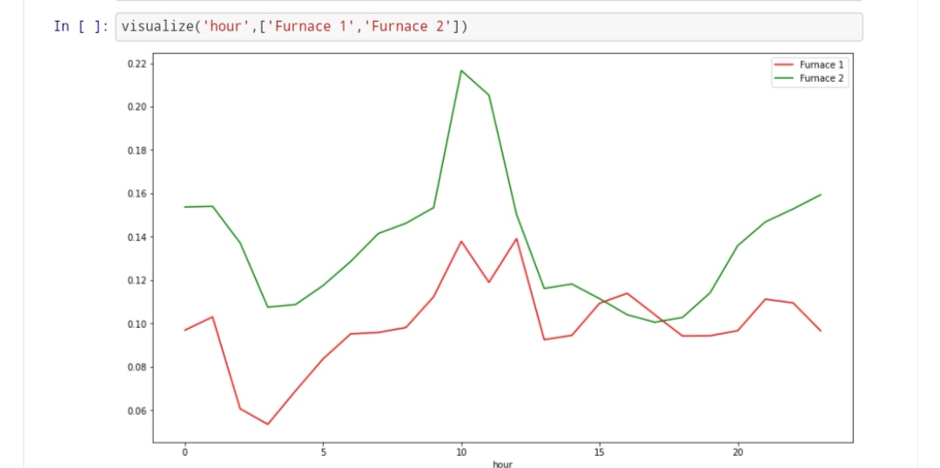

Slide 17
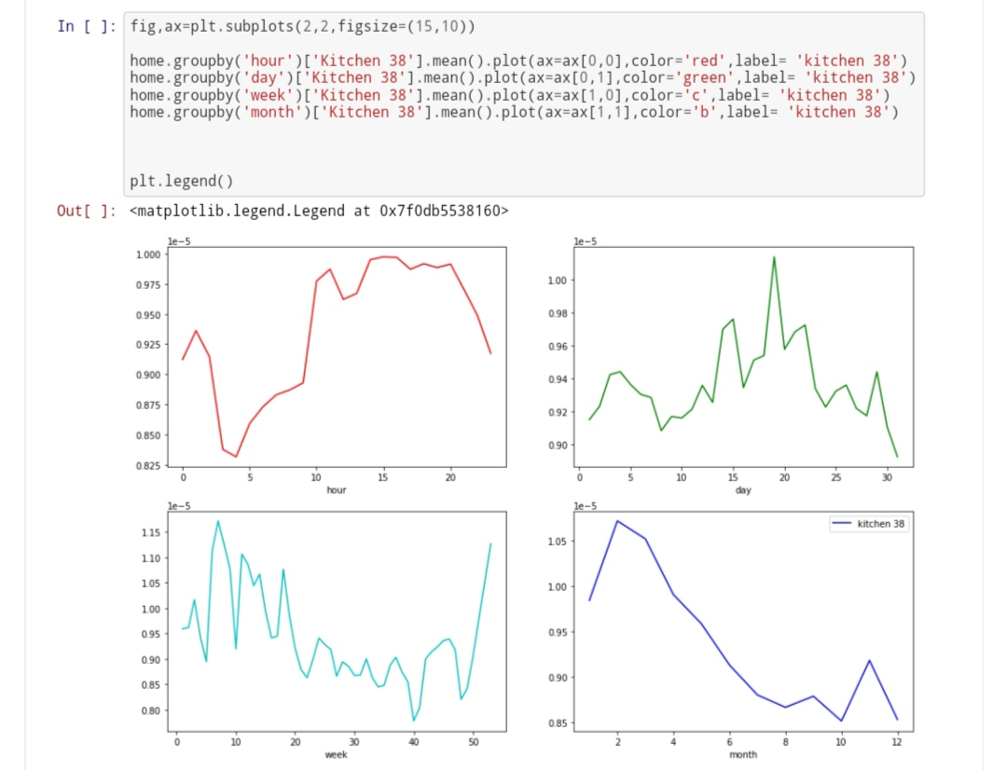
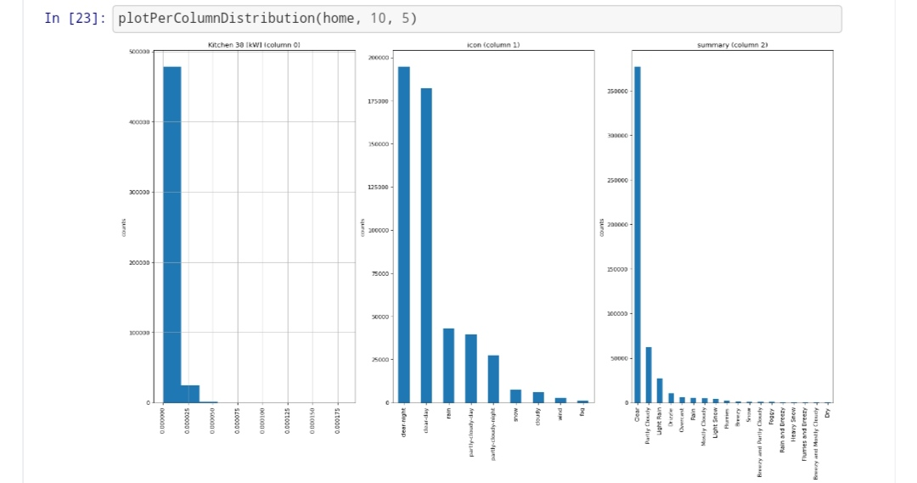

Slide 18
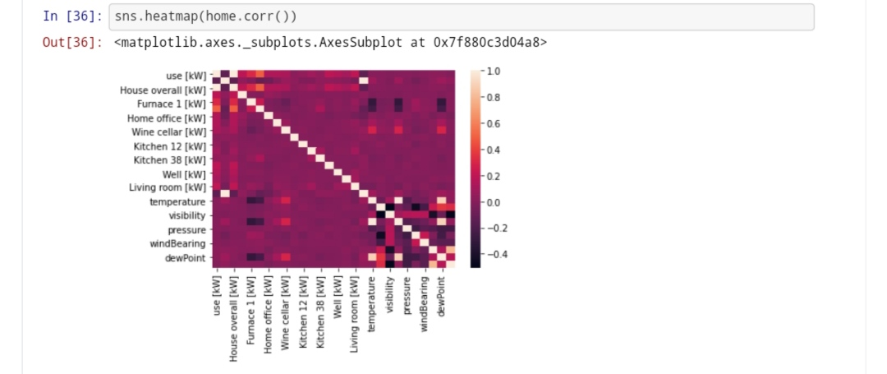

Slide 19
